Slide 1
API CHALLENGE
February 2019

Slide 2
agenda
introduction
PROJECT STRUCTURE
conclusions
Q&A

Slide 3
AGENDA
PROJECT STRUCTURE
Metrics and reports
sQ&A

Slide 4
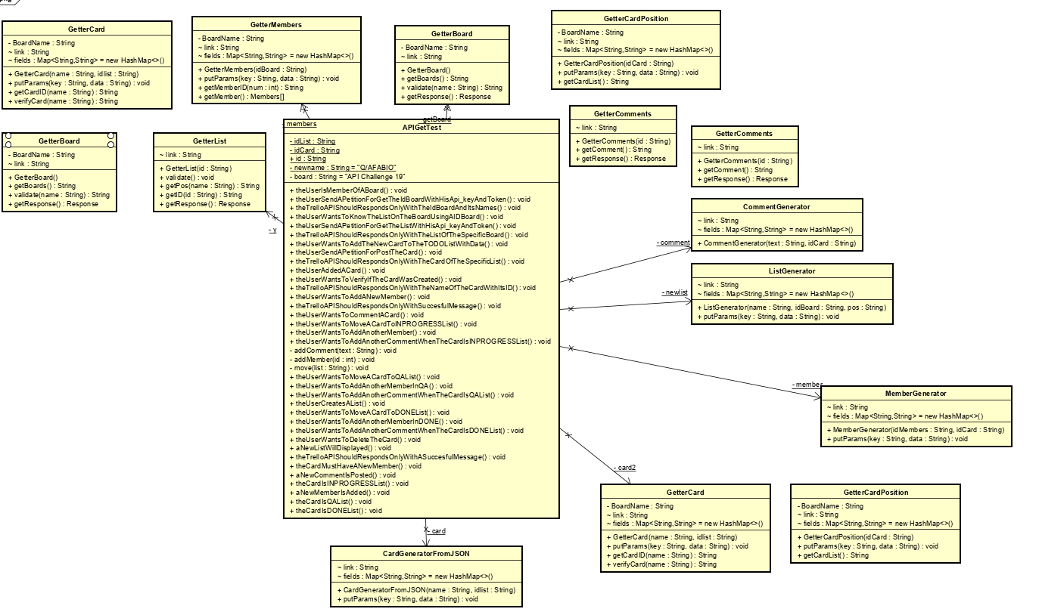
Class diagram

Slide 5

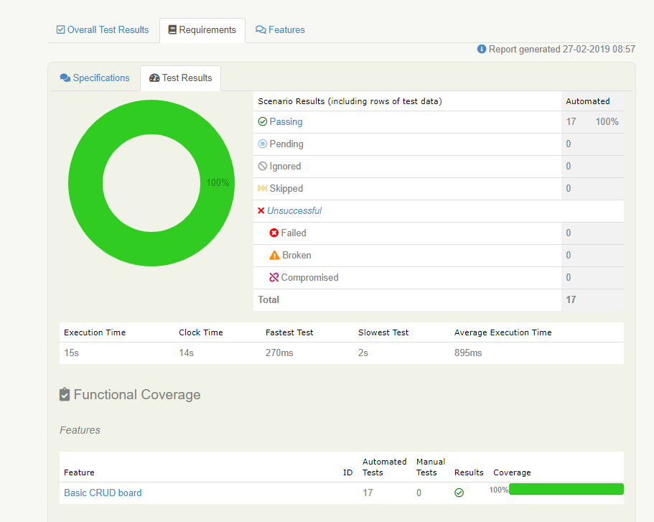
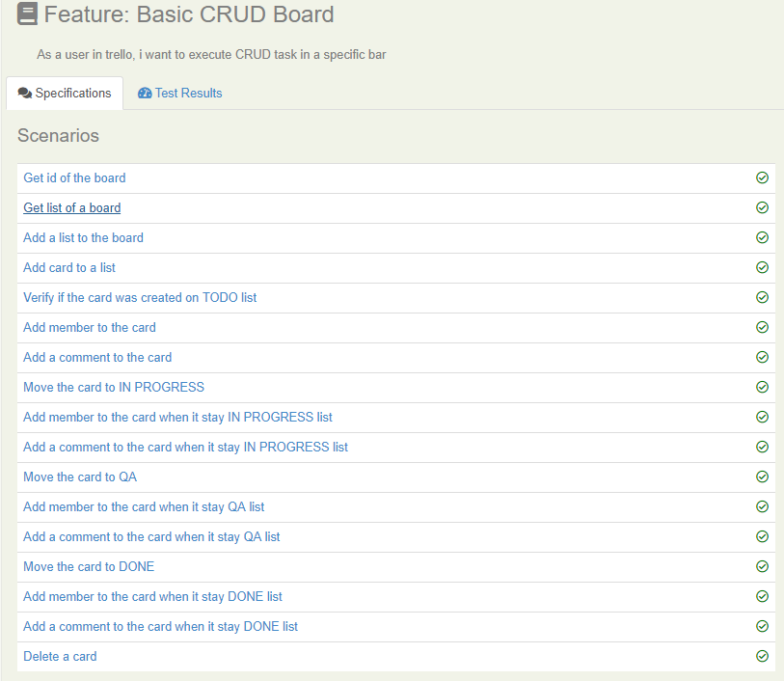
METRICS AND REPORTS
Report Summary

Slide 6
Fabio andres Bombiela ramirez
Testing intern
+57 3138595850
Fabio.bombiela@endava.com

